Slide 1
SMS Spam Detection
By:
Meetkumar Patel

Slide 2
Purpose
The main purpose of this presentation is to understand how I approached SMS Spam detection model training.
Particularly, this Presentation shows steps of building of SMS Spam detection.
This Presentation is about why and which steps to follow.

Slide 3
Data
To Train model of SMS Spam Detection used SMSSpamCollection.txt data is used.
In this Data there are Two Columns,
Target (Spam or Ham)
SMS Text
In this Data set there are 5572 SMS and their labels are there. Among them, 4825 are “ham” SMS and 747 are “spam” SMS.

Slide 4
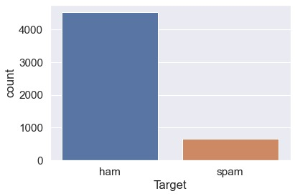
Data Analysis
There are 403 data are duplicate. For the future purpose these data are removed.
After removing duplicate data there are,653 “ Spam” SMS and 4516 “Ham” SMS.
Value count of data

Slide 5
Data Analysis
Now, Create new Column of length of the SMS text from this ,
Average Length of the “Ham” SMS is 70.90.
Average Length of the “Spam” SMS is 137.70.
From this information ,got to know that Spam SMS length is almost double then ham SMS length.

Slide 6
Data Pre-Processing
Data Pre-Processing technique that convert raw data into usable and understandable data.
First Pre-Processing step is Label Encoding of Target Column.
Data | Label Encoding
spam | 1
ham | 0

Slide 7
Data Pre-Processing
Second Step is to apply pre-processing on SMS text data.
There are some Basic Step for the text data pre-processing:-
Convert Text into Lower Case
Tokenization of text
Remove Special Characters
Remove Stop Words
Stemming of Words

Slide 8
Data Pre-Processing
Convert Text into Lower Case: This process convert text into lower case text.
(EX. India is The Grate. => india is the grate.)
Tokenization of text: Splitting the sentence text into small unit. (EX. india is the grate. => [‘india’ , ‘is’, ‘the’, ‘grate’ ])
Remove Special Characters: Removing some Special text characters like !@#$%^&*() etc.
(EX. India is @ The #Grate. => India is The Grate.)
Remove Stop Words : Removing English stopwords like this ,are,is etc. (EX. india is the grate. => india grate.)
Stemming of Words : Converting into root word. (EX. Playing or Played. => Play .)

Slide 9
Data Pre-Processing
One Main Step of text pre-processing is to convert text into numeric Vector because numeric vector process faster then normal text.
There are many types of Vectorization technique are available. Among them Tf-idf vectorization technique is used to train model.
Why tf-idf ? , Because other Vectorization techniques created a count of word occurrence in the sentence and in tf-idf created a importance value of the word.
The main reason to use tf-idf is that it perform effectively better and faster.
After all tis process data are clean to use for model training.

Slide 10
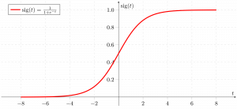
Model Training
To Create SMS Spam Detection model use “Logistic Regression” algorithm.
Why Logistic Regression? ,Because spamSMScollection data have binary target (Ex. ‘Spam’ or ‘ham’).
For this type of data logistic regression algorithm is used because this algorithm based on the concept of probability. It use sigmoid function to return probability value. It will return binary results like 0 or 1, yes or no.
Logistic Regression Graph

Slide 11
Model Testing
Testing Results of Logistic Regression trained model are,
So, this Logistic Regression model is give 95.55% accurate results. Which can be improved.
Accuracy | Precision
95.55 % | 94.44%

Slide 12
Like to improve
This Data is Imbalance data. “Ham” data count is 4516 and “Spam” data count is 653 which is very less compare to “Ham” data.
Because of that trained model biased towards classification. So , I like to do balanced this data by collection more “Spam” SMS.
There are many technique are also available for balancing data like, Resampling, Synthetic Minority Oversampling Technique, Balance Bagging Classifier etc.
There are many other advance algorithm are there So, I like to approach neural network model training method. Neural Network like ANN,RNN etc.

Slide 13
Conclusion
Data Analysis showing that data are imbalance data.in this data average length of the ham SMS is 70.90 and Average length of the spam data is 137.70.
There are many text pre-processing technique are available by using them we can clear the text into meaningful text and use this text to train models.
By Using Logistic Regression, It got 95.55 % accuracy.

Slide 14
End…
Thank You…

